Slide 1



Unveiling Happiness
A Data-Driven Insight into the World Happiness Report
Data Science Group 4

Slide 2


Agenda
Intro
Data
Learnings
Goal
Demo
Project Outline
Whiteboard
Challenges
Brainstorm
Data Science Group 4

Slide 3

Have you ever stopped to think...
What truly makes YOU happy?
World Happiness Report?
Data Science Group 4
BACK TO AGENDA PAGE

Slide 4




The World Happiness Report
by the United Nations
Well-being Meassurement
Quality of Life
Happier?
Project: TechLabs Düsseldorf Data Science Bootcamp
Data Science Group 4
BACK TO AGENDA PAGE

Slide 5







The World Happiness Report Data
Healthy Life Expectancy
GDP per Capita
Years expected to be lived in good health.
Quality healthcare, clean environment, and balanced diet lead to higher healthy life expectancy.
Promoting healthy lifestyles and healthcare access improve overall well-being and happiness.
Analyze the correlation between economic prosperity and life satisfaction in different countries.
Understand how income levels impact access to basic needs, healthcare, education, and overall quality of life.
Trust
Social Support
Transparency, accountability, and effective governance play key roles in building trust in governments.
Building trust in governments can lead to a more stable and harmonious society.
Trust in governments fosters a sense of security and optimism among citizens.
Influence of community, family, and friends on individual happiness.
Compare countries' social support systems and global happiness rankings.
Freedom
Generosity
Making life choices based on personal values and interests.
Expressing opinions and ideas without fear of censorship.
Freedom of movement and from discrimination.
Ensuring the right to fair treatment regardless of race, gender, religion, or other traits.
Exploring how giving back fosters fulfillment and community cohesion.
Analyze societal influences on altruism and happiness, and consider how promoting kindness can enhance societal harmony.
Data Science Group 4
BACK TO AGENDA PAGE

Slide 6


Goal
Review the data in the reports from 2015 to 2019 to pinpoint the factors contributing to a high ranking and uncover potential benefits for businesses.
Determining which continent has the highest number of countries at the top of the rankings.
Data Science Group 4
BACK TO AGENDA PAGE

Slide 7

Project Outline
Assumptions and Data Check
Methods of Data Analysis
Coding
Results
Explanation of various analytical methods used, implemented using Python:
Bar Plots using Matplotlib and Seaborn
Max Column analysis using Pandas
Map Visualization using Plotpy
Correlation analysis using statistical packages like NumPy and SciPy
Summary of main findings and insights derived from the analysis
Reflection on the effectiveness of the analytical methods employed
Consideration of future research directions or areas for further exploration
Higher scores in wealth, freedom, and region might lead to the top ranking
Description of data cleaning procedures to ensure data quality
Specific years for analysis to observe developmental trends
Checking the weigthed metrics
Mapping happiness distribution across countries
Identifying key happiness contributors
World map visualization
Correlation analysis
Data Science Group 4
BACK TO AGENDA PAGE

Slide 8
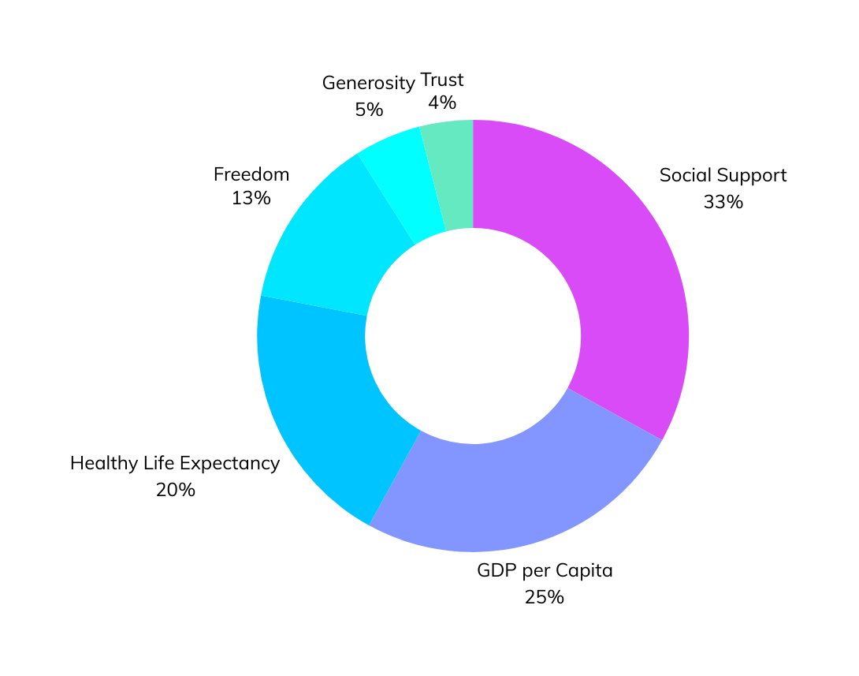

Challenges
Prioritization of Factors
Happiness vs. Quality of Life
Data Limitations and Interpretation
Subjectivity and Cultural Bias
Future Directions
Data Science Group 4
BACK TO AGENDA PAGE

Slide 9




Learnings
Technical & Personal Growth
Areas for Improvement
Project Phase Reflection
Expectations vs. Reality
Future Directions
Data analysis and visualization
Enhanced comumunication skills through collaboration
Importance of data cleaning procedures
Time and better coordination among the team
Reviewing the analysed data
Adjusted expectations based on evolving project needs and insights
Excited to apply newfound knowledge and skills to future projects.
Data Science Group 4
BACK TO AGENDA PAGE

Slide 10
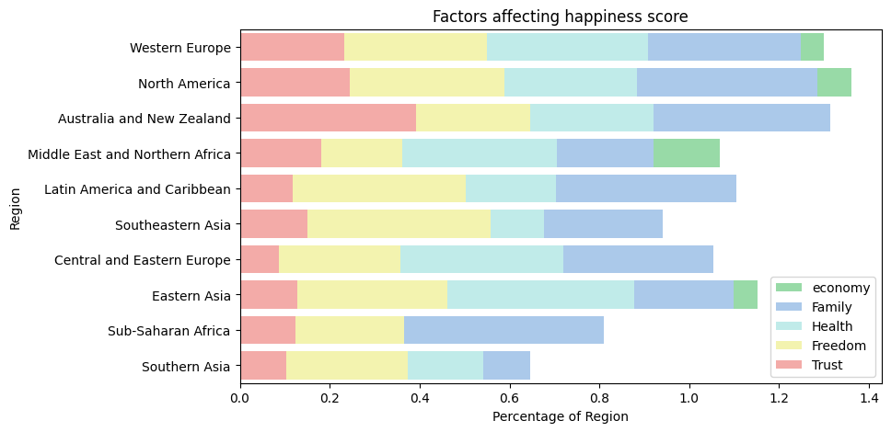
Demo
Analyzing Regional Happiness Distribution
Data Science Group 4
BACK TO AGENDA PAGE

Slide 11
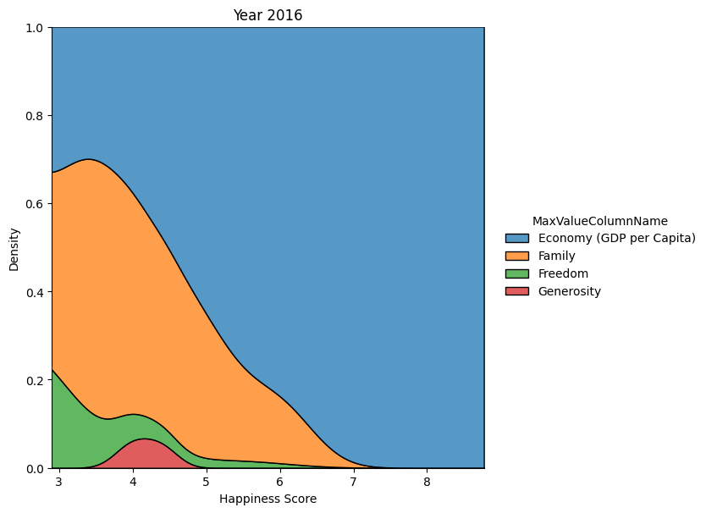
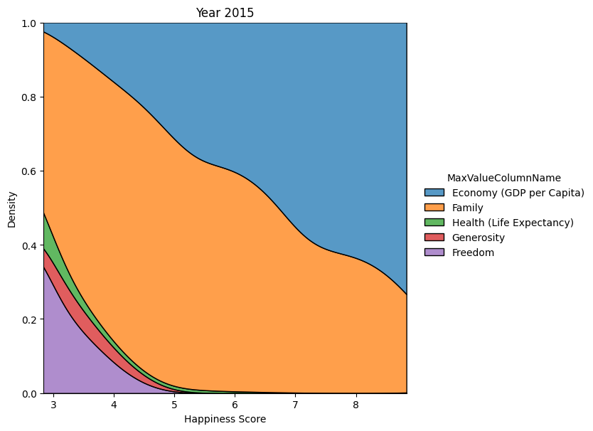
Demo
Unveiling Key Happiness Contributors
Data Science Group 4
BACK TO AGENDA PAGE

Slide 12
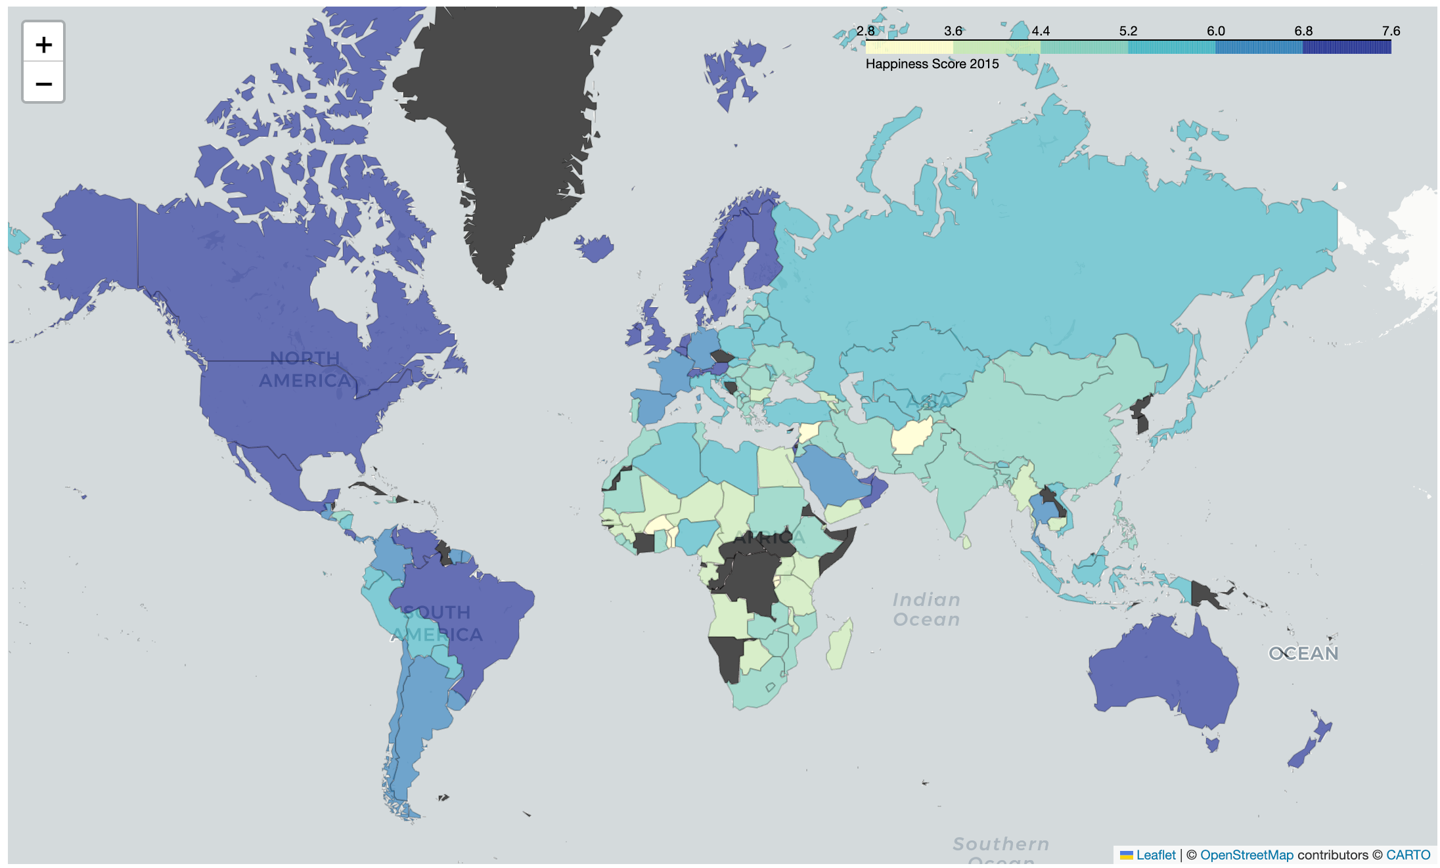
Demo
Mapping Happiness Scores
Data Science Group 4
BACK TO AGENDA PAGE

Slide 13
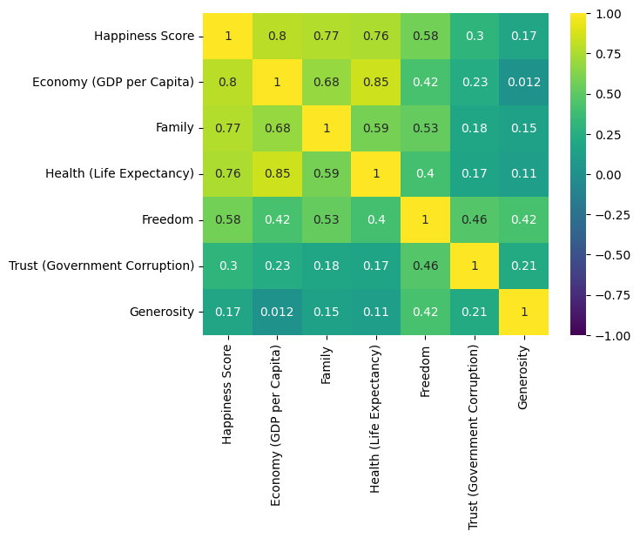
Demo
Heatmap
Data Science Group 4
BACK TO AGENDA PAGE

Slide 14
Demo
Heatmap
Data Science Group 4
BACK TO AGENDA PAGE

Slide 15
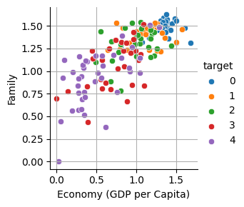
Conclusion
Possible future correlations
Importance for Business
Insight into societal well-being and consumer behavior
Influence on consumer preferences and market trends
Implications for tourism, hospitality
Relevance to Migration
Factors influencing individuals' decisions to migrate
Attraction of countries with high happiness rankings
Influence on immigration policies and workforce demographics
Data Science Group 4
BACK TO AGENDA PAGE

Slide 16

The Team
Paola Herrera
Janik
Nikolas
Data Science
Data Science
Data Science
Data Science Group 4
BACK TO AGENDA PAGE

